Slide 1
Journal club
R2 สริตา จินาวงศ์
อ.ณัฐธพงธ์ ภูวโชติโรจนโภคิน

Slide 2
Anesthesia-analgesia
April 2021

Slide 3
Background
The aspiration of gastric contents is a major cause of anesthesia-related fatality and complications.
Usually, gastric regurgitation and aspiration can be prevented by preoperative fasting in surgical patients.
To avoid pulmonary aspiration in such patients, the rapid sequence induction and intubation (RSII) technique has been used.

Slide 4
Background
The main mechanism of cricoid pressure is indirect occlusion of the esophagus between the cricoid cartilage and the bodies of the cervical vertebra.
However, cricoid pressure has been noted to have suboptimal effectiveness, because the esophagus might not be directly behind the cricoid cartilage.
Also, cricoid pressure can interfere with tracheal intubation by worsening the glottic view during direct laryngoscopy.

Slide 5
Background
Paralaryngeal or paratracheal pressure was more effective than cricoid pressure in occluding the esophagus or preventing the entrance of air into the stomach during mask ventilation.
Similar to cricoid pressure, paratracheal pressure may deteriorate the laryngoscopic view because the maneuver is applied to an adjacent region of the airway.
Therefore, we tested the hypothesis that paratracheal pressure would not deteriorate the glottic view during direct laryngoscopy, compared to cricoid pressure.

Slide 6
Method
Trial Design : Prospective, randomized, double-blind trial

Slide 7
Primary outcome
Incidence of deteriorated laryngoscopic view, evaluated by modified Cormack–Lehane grade with a predefined noninferiority margin of 15%.

Slide 8
Secondary outcome
Percentage of glottic opening score
Ease of mask ventilation
Change in ventilation volume and peak inspiratory pressure during mechanical mask ventilation
Ease of tracheal intubation
Resistance encountered while advancing the tube into the glottis

Slide 9
Method : Inclusion criteria
Ages ≥18 years
Scheduled for general elective surgeries

Slide 10
Method : Exclusion criteria
Risk for gastric regurgitation or with a history of operation on the neck or esophagus
Known stenosis or bruit of the left carotid artery
History of stroke or acute coronary syndrome in the preceding 3 months

Slide 11
Method
Randomized in a blinded 1:1 ratio

Slide 12
Method
All enrolled patients were randomly allocated to 1 of 2 groups: those in whom paratracheal pressure was applied and those in whom cricoid pressure was applied.
To this end, block randomization (block size of 10) was applied using a web-based random sequence generator (http://randomizer.org), and the results were printed and kept in an opaque envelope.
The sequence was managed by a research assistant who was not otherwise involved in the study.

Slide 13
Method
Anesthesiologists who performed mask ventilation and tracheal intubation were blinded from patient allocation by an opaque drape covering the patient’s neck and the maneuver provider’s hand.
The drape was maintained until the tracheal intubation was completed.
Mask ventilation, tracheal intubation, and glottic view grading were all performed by attending anesthesiologists with more than 10 years of experience in anesthesiology.

Slide 14
Sample size
Based on a previous study in which the glottic view during direct laryngoscopy was deteriorated in 12.5% of patients due to cricoid pressure, we assumed that paratracheal pressure might be clinically noninferior to cricoid pressure if the difference in the incidences of deteriorated laryngoscopic view between the paratracheal group and cricoid group was <15%.
We originally designed the study to have 80% power at the 0.05 1-sided α level to detect noninferiority of paratracheal pressure to cricoid pressure.
Allowing for a 10% dropout rate, we included 140 patients in the study.
In the review process, we were guided to test noninferiority using a 1-sided α of 0.025 and the corresponding 95% CI, as this is more standard practice.

Slide 15
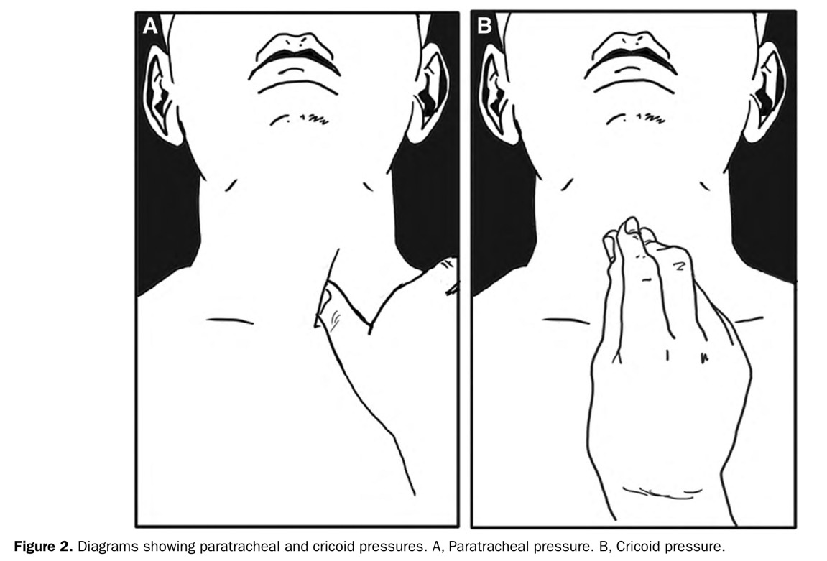
Intraoperative
Preoxygenation
Induction IV lidocaine , fentanyl , propofol , and rocuronium bromide - Oral airway
- Manual mask ventilation with 6% sevoflurane and oxygen
Ultrasound : relationship of the esophagus with the trachea and cricoid cartilage
Paratracheal group
Cricoid group
Applying the allocated intervention
Ease of manual bag-mask ventilation was graded using a 4-point scale

Slide 16
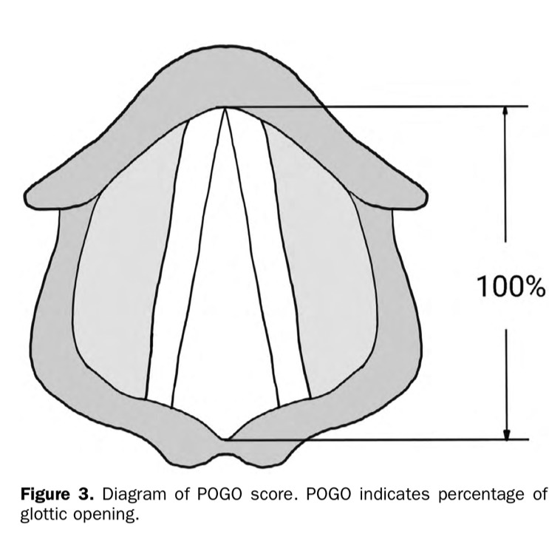
Intraoperative
Mechanical ventilation was applied with a facemask
Change in expired TV and PIP was recorded to evaluate airway obstruction.
2-handed technique
Allocated maneuver was released
Applying the allocated intervention
Expired TV and PIP had been recorded, the ventilatory parameters were recorded
Intubation with direct laryngoscope
LV view : POGO
Tube resistance while advancing the tracheal tube
The ease of tracheal intubation
Duration of intubation

Slide 17
Intraoperative
A researcher was trained in the application of paratracheal and cricoid pressure before the study period.
A 50 mL syringe model was used to train for applying the correct force.
Force compressing the volume of a syringe filled with air from 50 to 33 mL was measured as 30 N by scale.
The training was repeated at 2-month intervals throughout the study period to maintain the skill.

Slide 18
Intraoperative
All patients entered the operating room without premedication.
Routine monitoring included electrocardiography, noninvasive blood pressure, and pulse oximetry.
Anesthesia was induced after adequate pre-oxygenation, using intravenous lidocaine (30 mg), fentanyl (1–2 mcg/kg), propofol (1.5–2 mg/kg), and rocuronium bromide (0.6 mg/kg).
A Guedel airway was placed in each patient and maintained during manual and mechanical mask ventilation period.

Slide 19
Intraoperative
During mask ventilation using 6% sevoflurane with oxygen, the transverse spatial relationship of the esophagus with the trachea and cricoid cartilage in the patient was examined with a 5 to 12 MHz linear ultrasound transducer
The examination focused on the lower-left paratracheal region and the cricoid cartilage-containing region.

Slide 20
Intraoperative
The position of the esophagus in relation to the trachea and the cricoid cartilage : 5 categories
(1) Left
(2) Partial left
(3) Middle
(4) Partial right
(5) Right

Slide 21
Intraoperative
After the ultrasound examination, the effect of the allocated maneuver on manual bag-mask ventilation was evaluated.
In the paratracheal group, a pressure of 30 N against the vertebral body was applied by the researcher’s thumb, at the left side of patient’s trachea, immediately above the left clavicle and medial to the sternocleidomastoid muscle.
In the cricoid group, cricoid pressure was applied with a single-handed 3-finger maneuver.
The group allocation was maintained throughout the study period.
In both groups, the chosen maneuver was initiated based on viewing real-time images of the target area.

Slide 22
Intraoperative
While applying the allocated intervention, ease of manual bag-mask ventilation was graded using a 4-point scale: (1) Easy (2) Moderate (3) Difficult (4) Impossible

Slide 23
Intraoperative
Thereafter, after the allocated maneuver was released, mechanical ventilation was applied with a facemask.
Change in expired TV and PIP) was recorded to evaluate airway obstruction.
Mechanical ventilation : VCV mode : TV of 8 mL/kg, RR 12 /min , PEEP 5 cm H2O, and an I:E=1:2, with 6% sevoflurane with oxygen.
The facemask was held using a 2-handed technique.

Slide 24
Intraoperative
After baseline expired tidal volume and PIP had been recorded, the ventilatory parameters were recorded while applying the allocated intervention.
All ventilatory parameters were recorded once they had reached a steady state.
Subsequently, the effect of the maneuver on the LV view was evaluated.
The effect of each maneuver was defined as the incidence of deteriorated glottic view during direct laryngoscopy using the allocated maneuver, compared to the view without the maneuver

Slide 25
Intraoperative
Subsequently, the effect of the maneuver on the LV view was evaluated.
The effect of each maneuver was defined as the incidence of deteriorated glottic view during direct laryngoscopy using the allocated maneuver, compared to the view without the maneuver.
Initially, sequential glottic views with and without an allocated maneuver were evaluated using the modified Cormack–Lehane grade for the primary end point, which subdivides grade 2 of the original Cormack–Lehane grade into grades 2a and 2b (2a, partial view of glottis; 2b, only arytenoid cartilages evident) and percentage of glottic opening (POGO) score for a secondary end point, to increase the sensitivity for laryngoscopic view deterioration.
As a primary end point, the change in modified Cormack–Lehane grade was categorized into binary values for noninferiority assessment: “worsened” and “not worsened.” “Worsened” Cormack–Lehane grade was defined as a decrease of glottic exposure, for example, grade 1 to grade 2a,2b,3,or4,or grade 2a to 2b, 3,or 4.
We used a binary outcome because we were interested in whether the maneuvers deteriorate laryngoscopic view or not.
In addition, the change in POGO score was also recorded.

Slide 26
Intraoperative

Slide 27
Intraoperative
As POGO score was recorded by a 10% interval, a decrease of POGO score ≥10% was recorded as “worsened.”
After evaluating the laryngoscopic view, tracheal intubation was conducted during the application of each intervention.
Tube resistance while advancing the tracheal tube through the glottis was evaluated on a 4-point scale: - Slight - Moderate - Severe - Obstructed
The ease of tracheal intubation was also evaluated using a 4-point scale: - Easy - Moderate - Difficult - Impossible

Slide 28
Intraoperative
Also, duration of intubation was recorded.
Duration of intubation was defined as the time interval between insertion of the tracheal tube into the oral cavity and the confirmation of the capnography.
If the allocated maneuver was released to complete tracheal intubation, the case was recorded along with the reason for release of the maneuver.

Slide 29
Intraoperative
The esophagus positions relative to the cricoid cartilage and trachea were categorized into binary variables to compare the anatomical suitability of compression in both regions: suitable (partial left or left in the lower-left paratracheal region; mid, partial left, or partial right in the cricoid region) or unsuitable (mid, partial right, or right in the lower-left paratracheal region; left or right in the cricoid region).

Slide 30
Statically analysis
Deterioration of LV, which was assessed by the modified Cormack–Lehane grade and POGO score, was tested for noninferiority, while all other secondary end points were tested for superiority with a 2-sided significance level of 0.05.
Noninferiority was assessed in a 1-sided test with the use of a 2-sided 95% confidence interval (CI) for differences of the incidence of deteriorated laryngo- scopic view.
If the upper limit of the 95% CI of the difference was <15%, then paratracheal pressure would be deemed noninferior to cricoid pressure.
The non-inferiority margin was set at absolute 15% difference that was assumed to be clinically acceptable given the incidence of deterioration of glottic view during cricoid pressure application, which had been reported from 12.5% to 45%.
Among secondary outcomes, duration of intubation and changes in PIP before and after the maneu- vers were assessed using an independent t test or Mann-Whitney U test, according to the variable normality.
Ordinal data, such as ease of mask ventilation or tracheal intubation, and resistance encountered while advancing the tube into the glottis, were exam- ined using the ordinal logistic regression analysis.
Proportional odds assumption was checked with a graphical technique and Brant’s test.
The odds ratio calculated the odds of having a worse outcome in the paratracheal group compared to the cricoid group.
The incidence of release of the maneuvers was evaluated using the χ2 test or Fisher exact test.
All statistical analyses were performed using R software, version 3.6.2 (R Foundation for Statistical Computing, Vienna, Austria).
Notes:
One-way ANOVA was used to analyze BMI, duration, MAP, pain and patient satisfaction ratings, Tinetti score, distance ambulated, and hospital length of stay variables.
Chi-square test or Kruskal–Wallis test, was used to analyze sex, ASA Physical Status, Charlson Comorbidity Index, surgical approach, surgeon muscle tension rating, return of motor function, same-day discharge, urinary retention, and dizziness.

Slide 31
Statically analysis
Deterioration of LV, which was assessed by the modified Cormack–Lehane grade and POGO score, was tested for noninferiority, while all other secondary end points were tested for superiority with a 2-sided significance level of 0.05.
Secondary outcomes, duration of intubation and changes in PIP before and after the maneuvers were assessed using an independent t test or Mann-Whitney U test, according to the variable normality.
The odds ratio calculated the odds of having a worse outcome in the paratracheal group compared to the cricoid group.
All statistical analyses were performed using R software, version 3.6.2 (R Foundation for Statistical Computing, Vienna, Austria).
Notes:
One-way ANOVA was used to analyze BMI, duration, MAP, pain and patient satisfaction ratings, Tinetti score, distance ambulated, and hospital length of stay variables.
Chi-square test or Kruskal–Wallis test, was used to analyze sex, ASA Physical Status, Charlson Comorbidity Index, surgical approach, surgeon muscle tension rating, return of motor function, same-day discharge, urinary retention, and dizziness.

Slide 32
Result

Slide 33
Result

Slide 34
Result

Slide 35
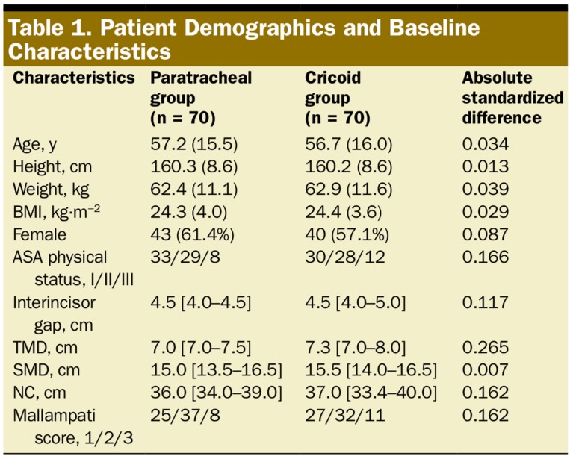
Result
No difference was observed

Slide 36
Primary outcome

Slide 37
Secondary outcomes

Slide 38
Discussion
We found that paratracheal pressure is noninferior to cricoid pressure with respect to the effect on the glottic view during direct laryngoscopy in terms of modified Cormack–Lehane grade.
When evaluated with POGO score, paratracheal pressure also was noninferior to cricoid pressure with respect to the LV.
Mask ventilation was easier with the paratracheal pressure than with the cricoid pressure.
However, the ease of intubation did not differ between the 2 maneuvers.

Slide 39
Discussion
In this study, external laryngeal manipulation to improve the glottic view was not applied during direct laryngoscopy.
During the application of cricoid pressure, external laryngeal manipulation might deteriorate LV.
In addition, external laryngeal manipulation might reduce the efficacy of cricoid pressure by altering the alignment of the cricoid cartilage, esophagus, and vertebral bodies.
However, paratracheal pressure may be less affected by external laryngeal manipulation, as manipulation sites are relatively far from each other.

Slide 40
Discussion
An additional safety concern has been that cricoid pressure can worsen bag-mask ventilation.
In this study, paratracheal pressure had a smaller adverse effect on bag-mask ventilation, compared to cricoid pressure.
Manual bag-mask ventilation was easier with paratracheal pressure.
The increase in PIP during mechanical mask ventilation was significantly less in the paratracheal group.
In 9 patients in the cricoid group (12.9%), PIP increased by more than half of the baseline airway pressure.
Moreover, a patient in the cricoid group exhibited total obstruction and could not be ventilated during mask ventilation.

Slide 41
Discussion
Airway obstruction during manual ventilation may increase the risk for gastric insufflation, by increasing PIP to overcome airway obstruction.
Although there have been some reports that cricoid pressure successfully suppresses gastric insufflation, air might pass through the compressed region when airway pressure exceeds the capacity of cricoid pressure.
If the larynx collapses during the application of cricoid pressure, resistance may increase during tracheal tube advancement.
In 2 patients in this study, cricoid pressure was released to advance the tracheal tube through the glottis, due to severe resistance.
Conversely, no such events occurred in the paratracheal group.

Slide 42
Discussion
To occlude the esophagus with paratracheal or cricoid pressure, the esophagus should be located in an adequate location: to the lower left of the trachea for paratracheal pressure and behind the cricoid cartilage for cricoid pressure.
When the lower-left paratracheal and cricoid regions were compared for anatomical suitability for esophageal compression, the esophageal location in the lower-left paratracheal region was more suitable for compression, compared to the cricoid region.
With cricoid pressure, successful esophageal compression occurs indirectly via the posteriorly directed cricoid cartilage.
For this to be effective, the cricoid cartilage must completely or partially over-lie the esophagus.

Slide 43
Discussion
The esophagus that partially overlaps the cricoid cartilage may not be obstructed by cricoid pressure because cricoid pressure can shift the esophagus laterally.
In contrast, paratracheal pressure is directly applied to the esophagus in the lower-left paratracheal region, but it is still important to know the consistency of its location.
There could be an argument whether the position of the esophagus is a relevant factor of the effectiveness of cricoid pressure.
In a magnetic resonance imaging–based study, cricoid pressure compressed the postcricoid hypopharynx, which is an anatomical unit with the cricoid cartilage, rather than the esophagus.
In this study, the postcricoid hypopharynx was compressed by cricoid pressure against the vertebral body or longus colli muscle group regardless of the location of the esophagus.
However, still paratracheal pressure might be useful as paratracheal pressure compressed the esophagus directly against the vertebral body and occluded it.

Slide 44
Discussion
In 2 patients, the esophagus was found on the patient’s right side in the lower paratracheal region.
In one of these patients, it was repositioned after tracheal intubation, then found in the lower-left paratracheal region
This suggests that when pressure is applied to surrounding structures, the position of the esophagus can change.
Therefore, the exact location of the esophagus can be determined with ultrasound examination.
However, in the absence of ultrasound, the lower-left paratracheal region is presumably effective for esophageal compression in most patients.

Slide 45
Limitation
First, the sample size was calculated for a 1-sided noninferiority test with an of 0.05. However, noninferiority should be assessed with an of 0.025 on the indicated side with the use of a 95% CI.
Second, intubation success rate was not evaluated as a primary end point. A randomized controlled trial of the 2 techniques for comparing intubation success rates was impractical as they require enormous sample sizes given the high intubation success rates.

Slide 46
Limitation
Third, the noninferiority margin of 15% might have been high and there was a risk for type I error.
Fourth, we used a same block size for block randomization. Although anesthesiologists were not aware of the randomization sequence, different block sizes should be used to ensure optimal blinding.
Finally, the effects of paratracheal and cricoid pressures were only evaluated in patients with normal airways undergoing elective surgery. The results might be different in patients with difficult airways.

Slide 47
Conclusion
In conclusion, paratracheal pressure was noninferior to cricoid pressure with respect to the effect on the glottic view during direct laryngoscopy.
Mask ventilation was easier with the paratracheal pressure than with the cricoid pressure, however, the ease of intubation did not differ between the 2 maneuvers.

Slide 48
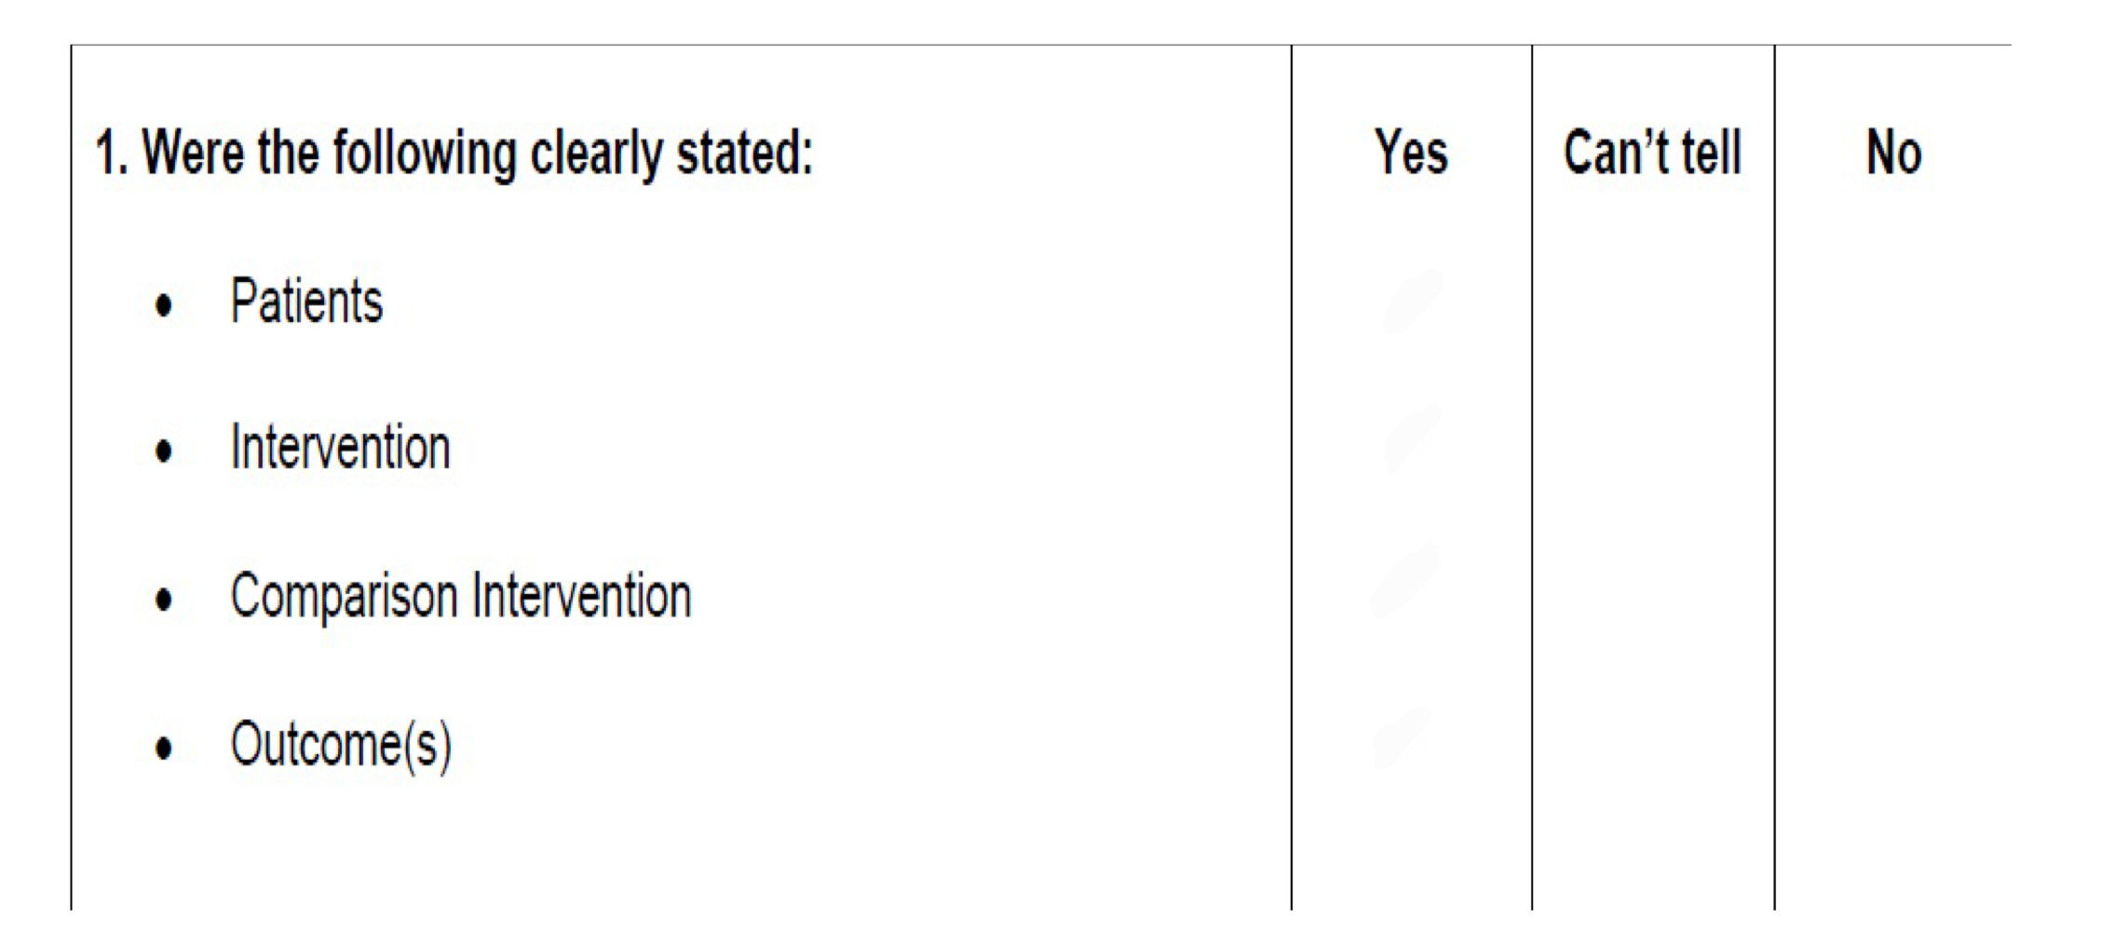
Critical appraisal : RCT
Does this study address a clear question?

Slide 49
Critical appraisal : RCT
Are the results of this single trial valid?

Slide 50
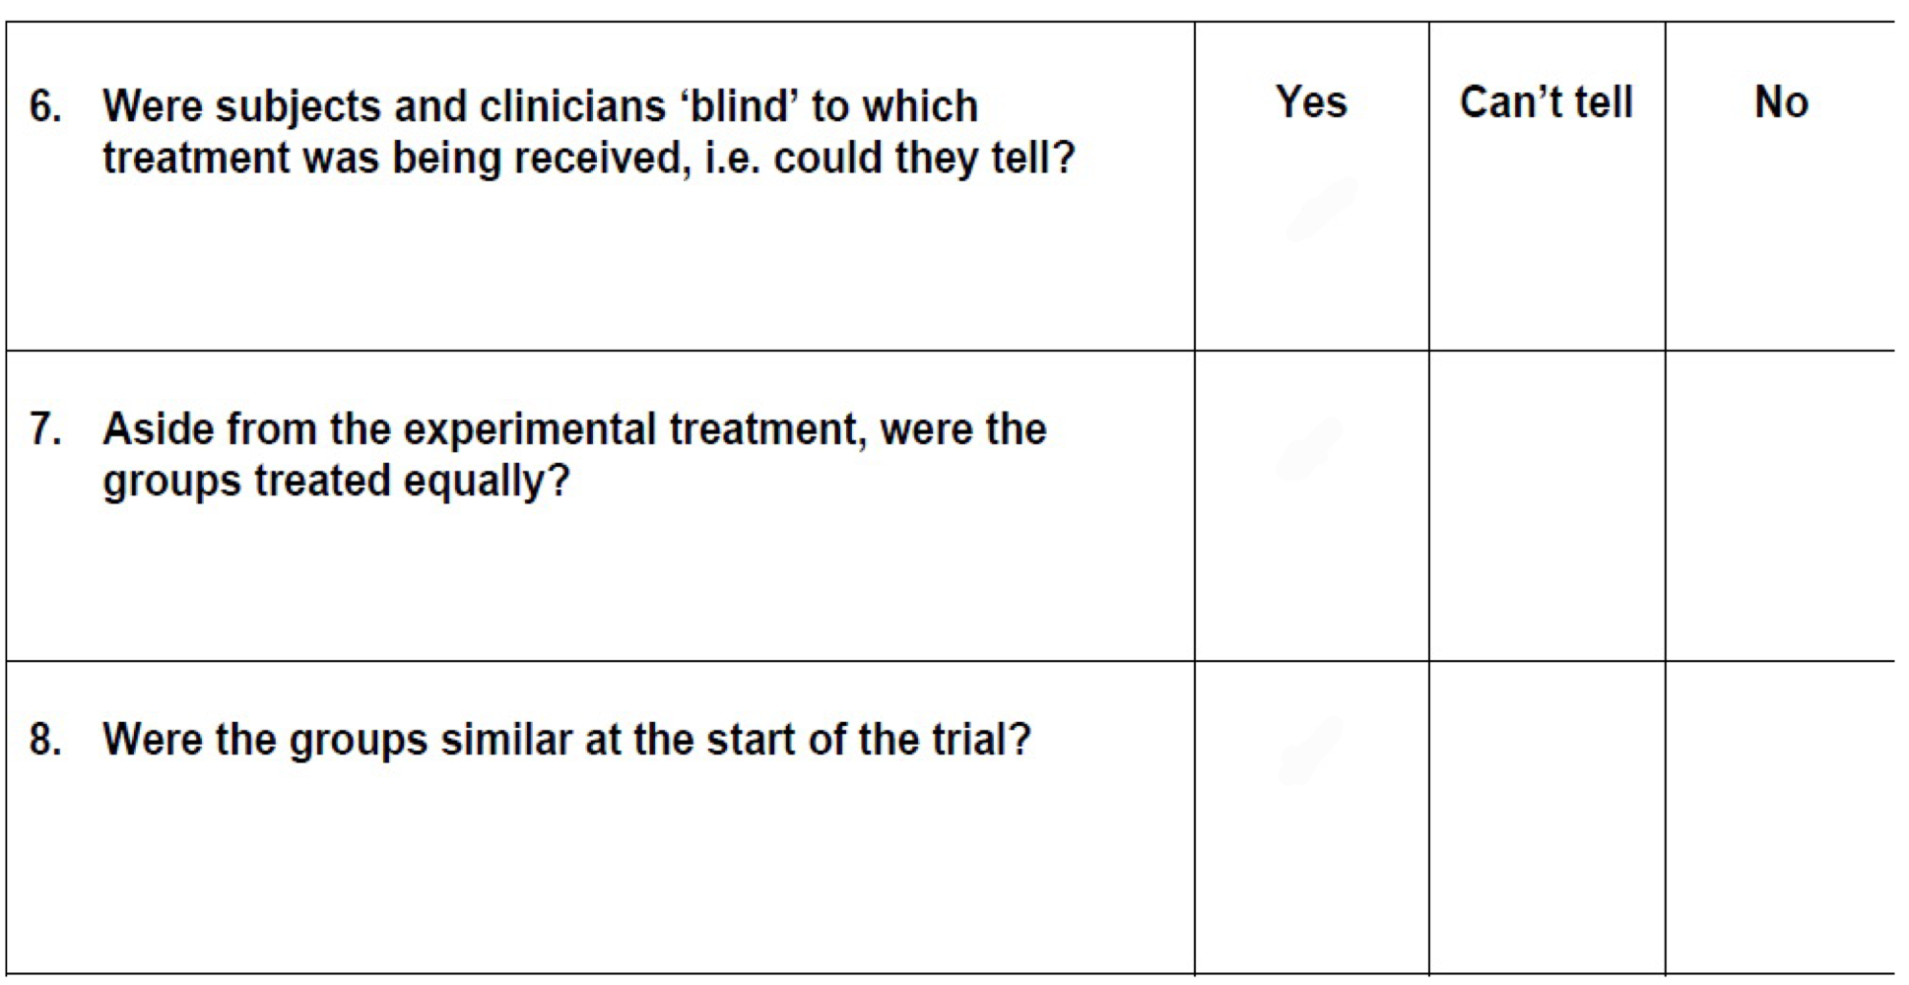
Critical appraisal : RCT
Are the results of this single trial valid?

Slide 51
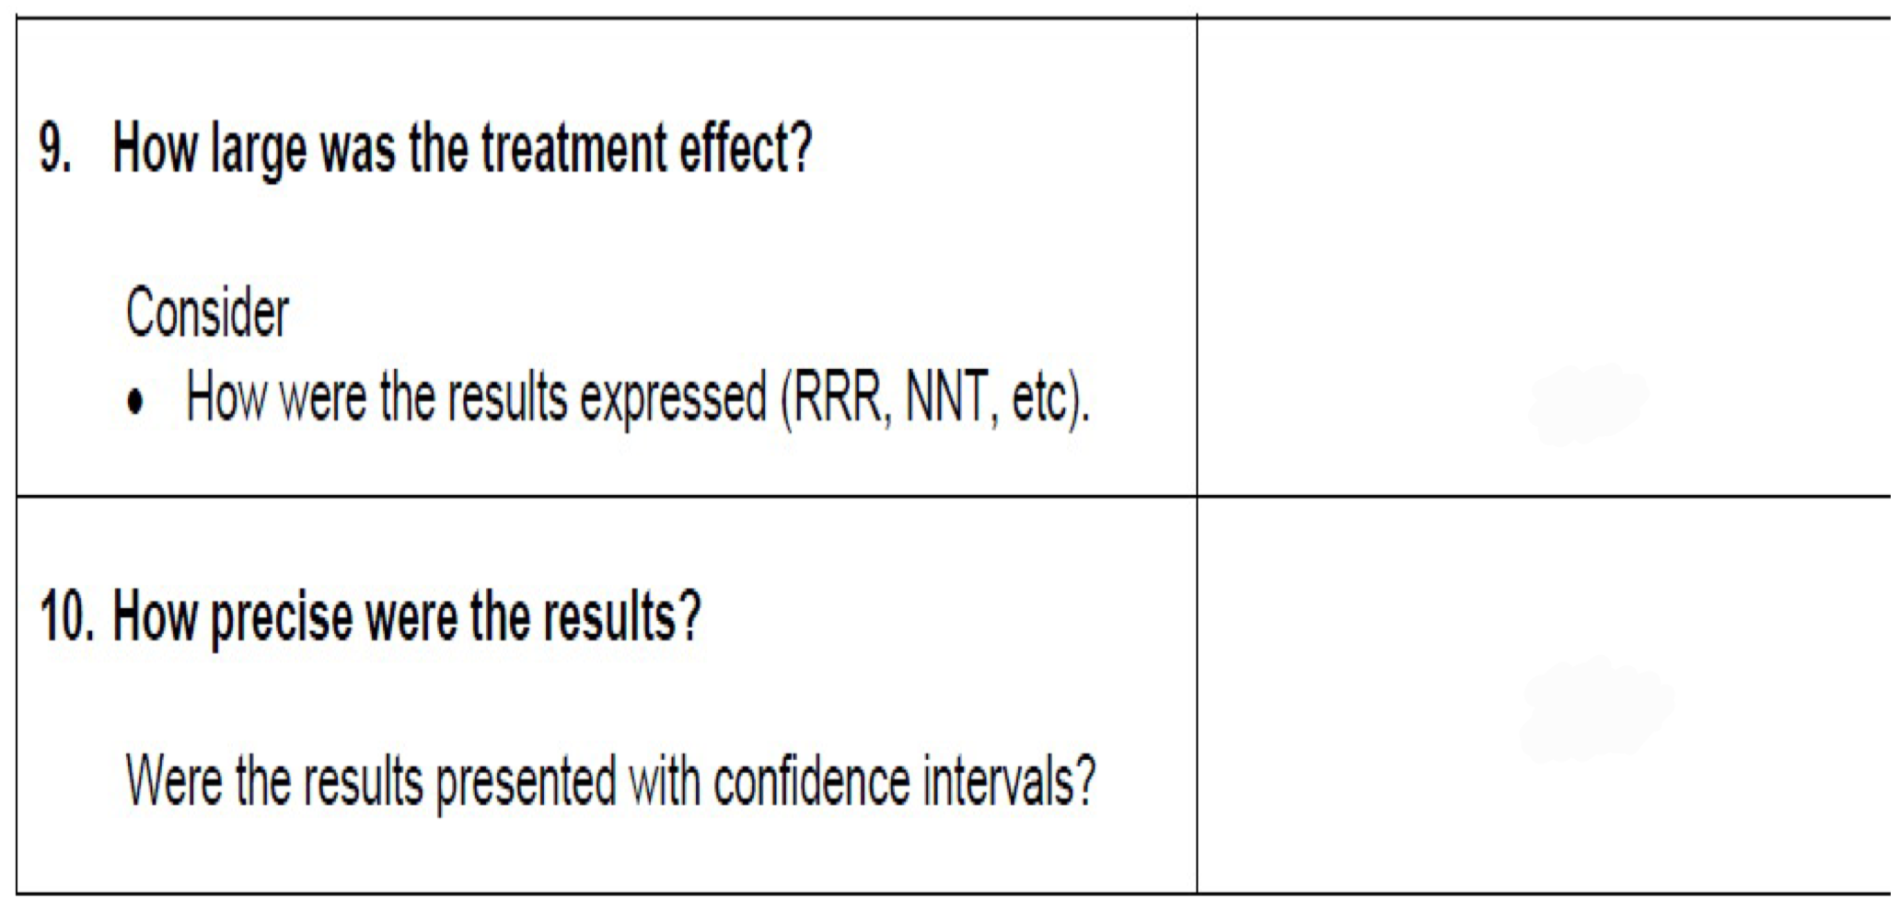
Critical appraisal : RCT
What were the results?
?
Yes

Slide 52
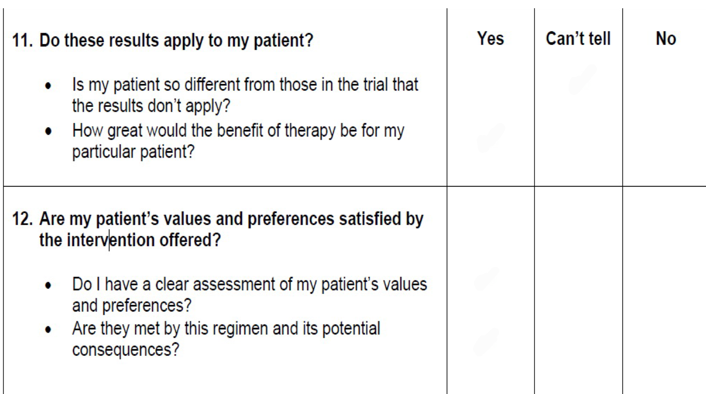
Critical appraisal : RCT
Can I apply these valid, important results to my patients?

Slide 53
Thank you

